Slide 1
TEAM
NOCK-NOCK
NATHAN DAVIDS
OKUHLE CHARLIEMAN
COLE HANEKOM
KIRAN ISAACS
WEEK 1 PRESENTATION

Slide 2
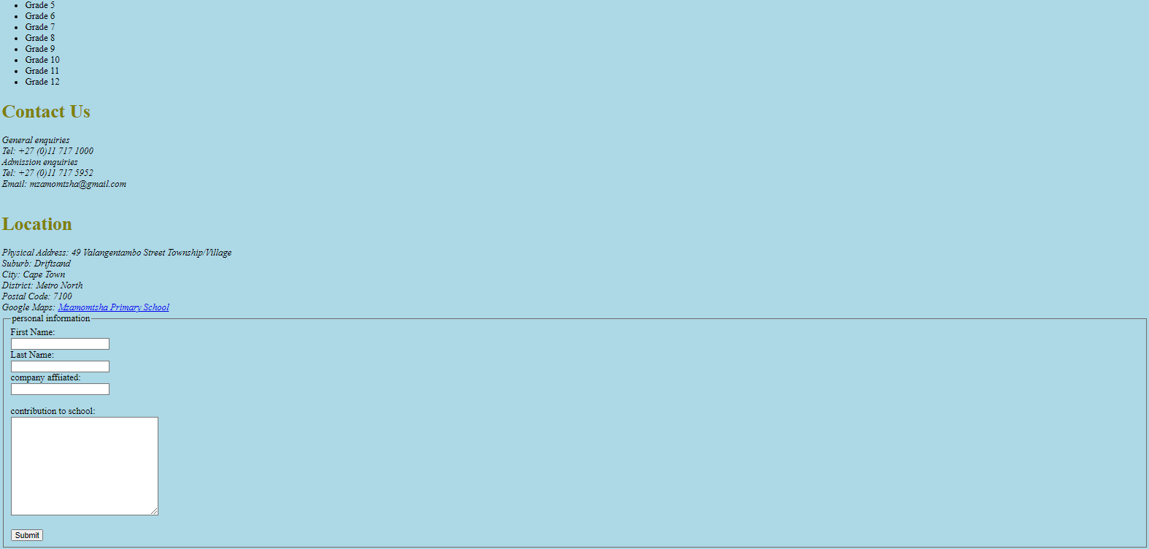
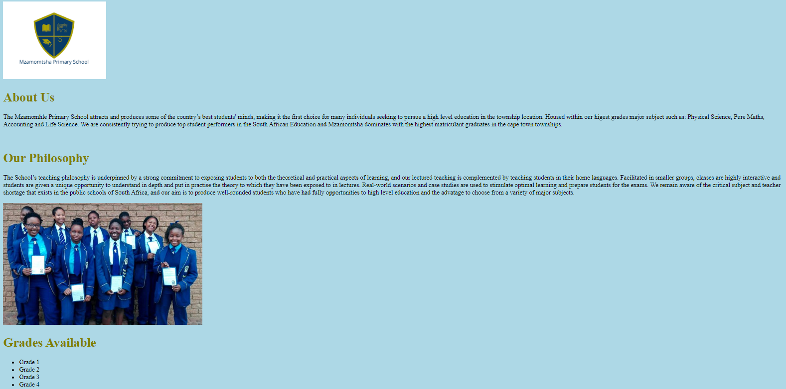
WEB PAGE

Slide 3
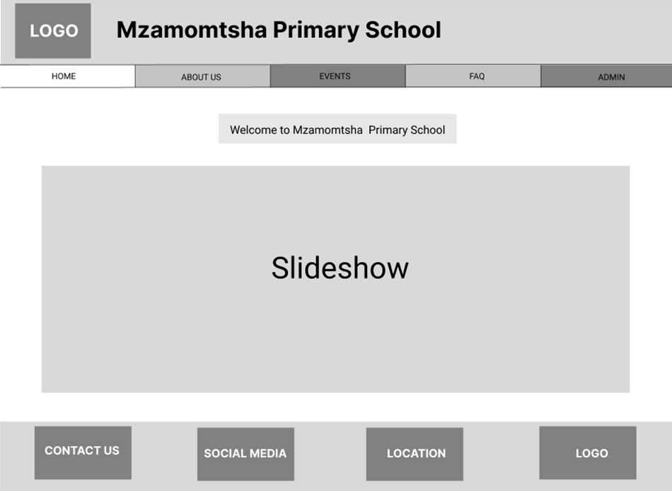
MAIN PAGE DESIGN

Slide 4
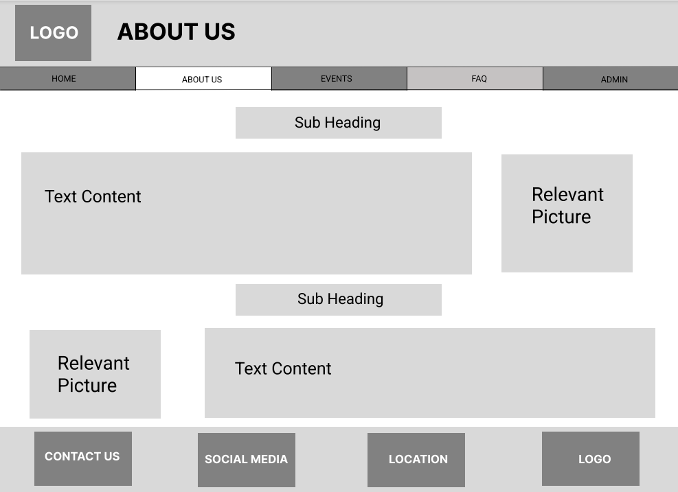
ABOUT US PAGE DESIGN

Slide 5
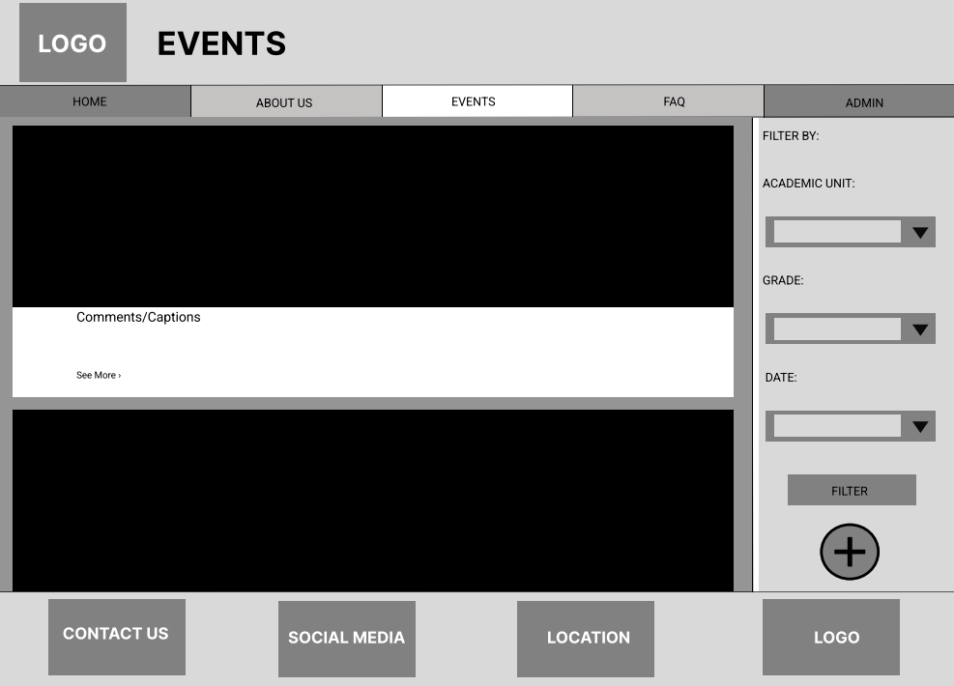
EVENTS PAGE DESIGN

Slide 6
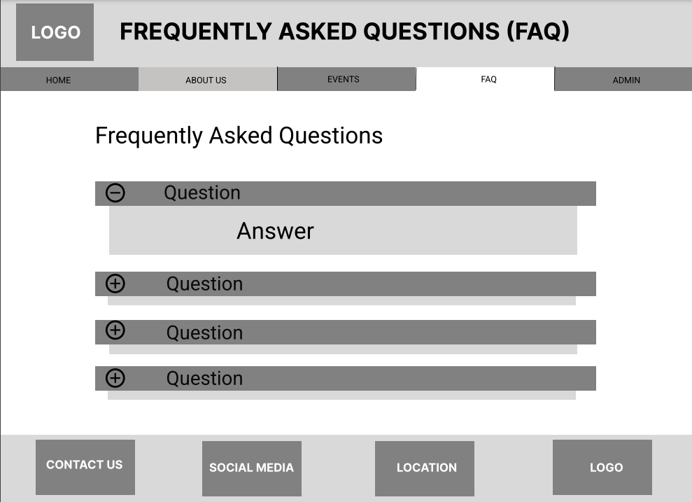
FAQ PAGE DESIGN

Slide 7

THANKS!
Does anyone have any questions?

